Slide 1
ABC Bank Customer Base Analysis.
Bank operates in the United Kingdom.
Datasets consist of:
Customer ID, customer first name, customer last name, gender, age, region customer is located (England, Northern Ireland, Wales, or Scotland). Job classification, whether the customer is a white collar, blue collar or other. Date the customers joined the bank between January to December 2015. Balance on the account of the customers in pounds.
Total dataset 4014 rows.
Analyze how different regions are represented in the bank customer baseline. Report should consist of visuals, a dashboard, and a storyline to portray what bank customers' baseline looks like to the executive management, including all the uncovered findings.

Slide 2
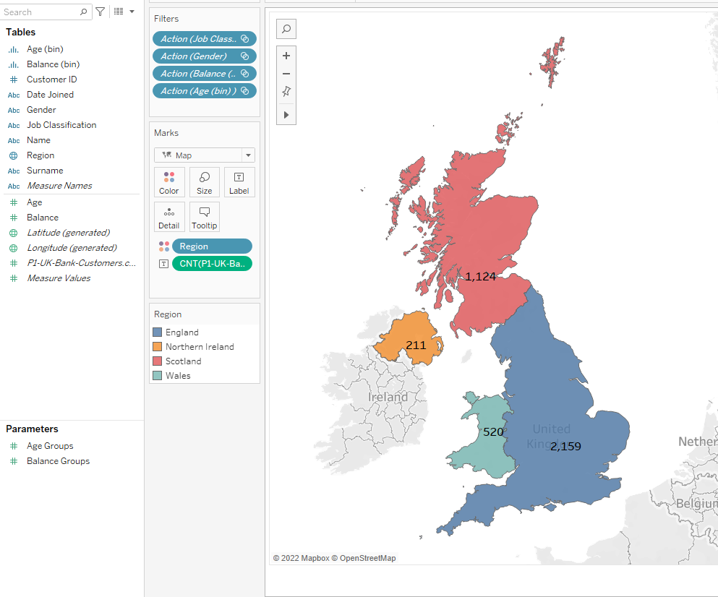
United Kingdom Map

Slide 3
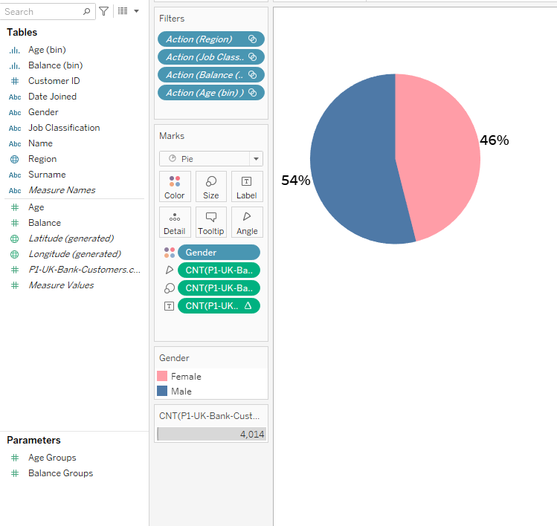
Gender

Slide 4
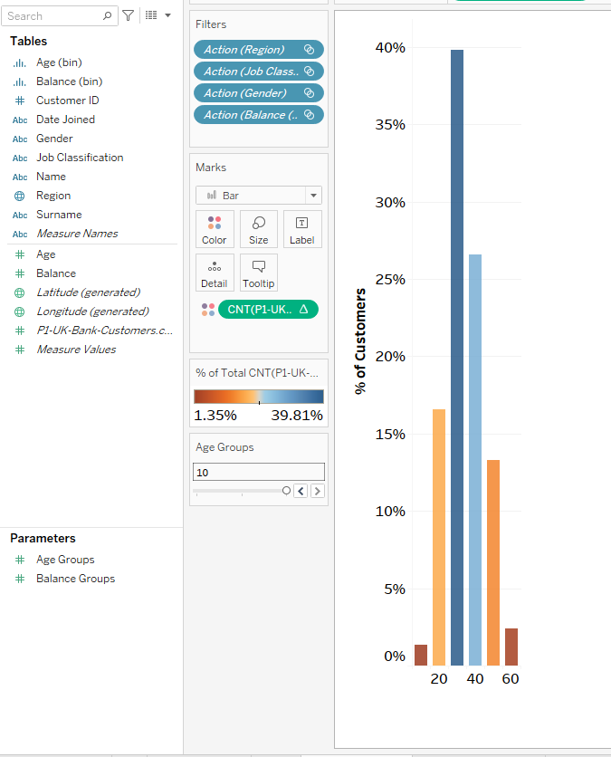
Distribution by Age

Slide 5
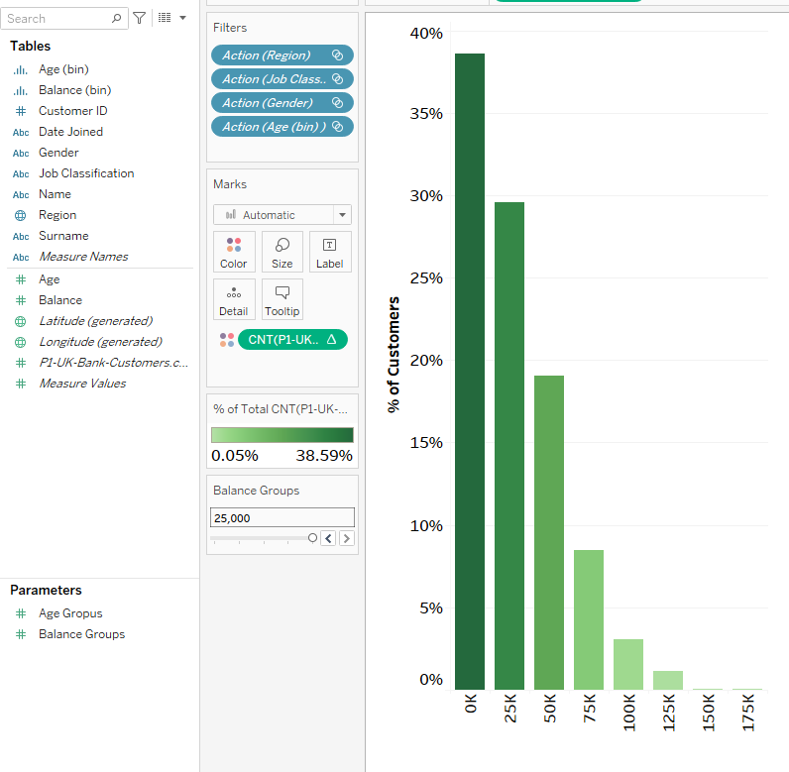
Distribution by Balance

Slide 6
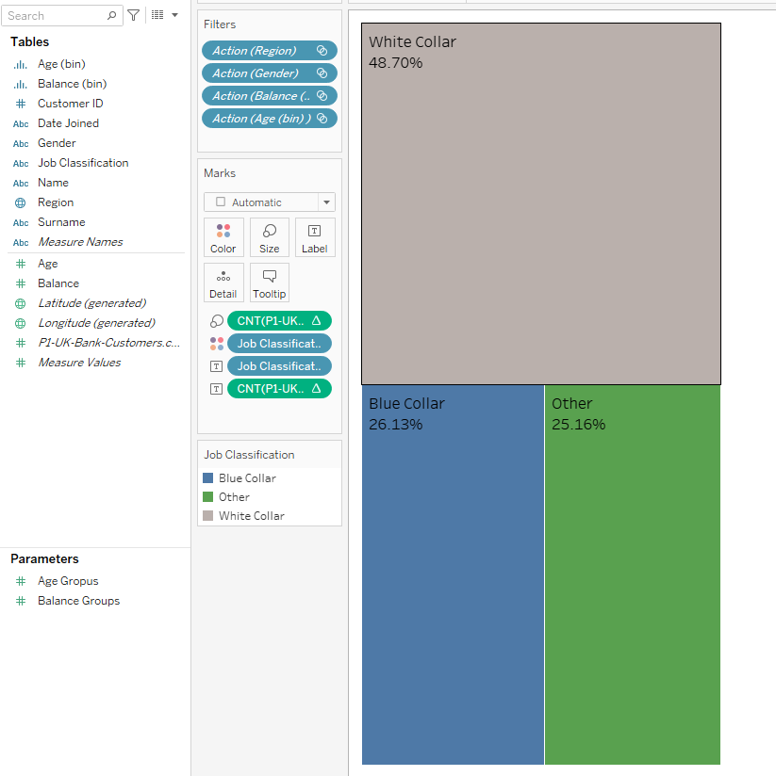
Job Classification

Slide 7
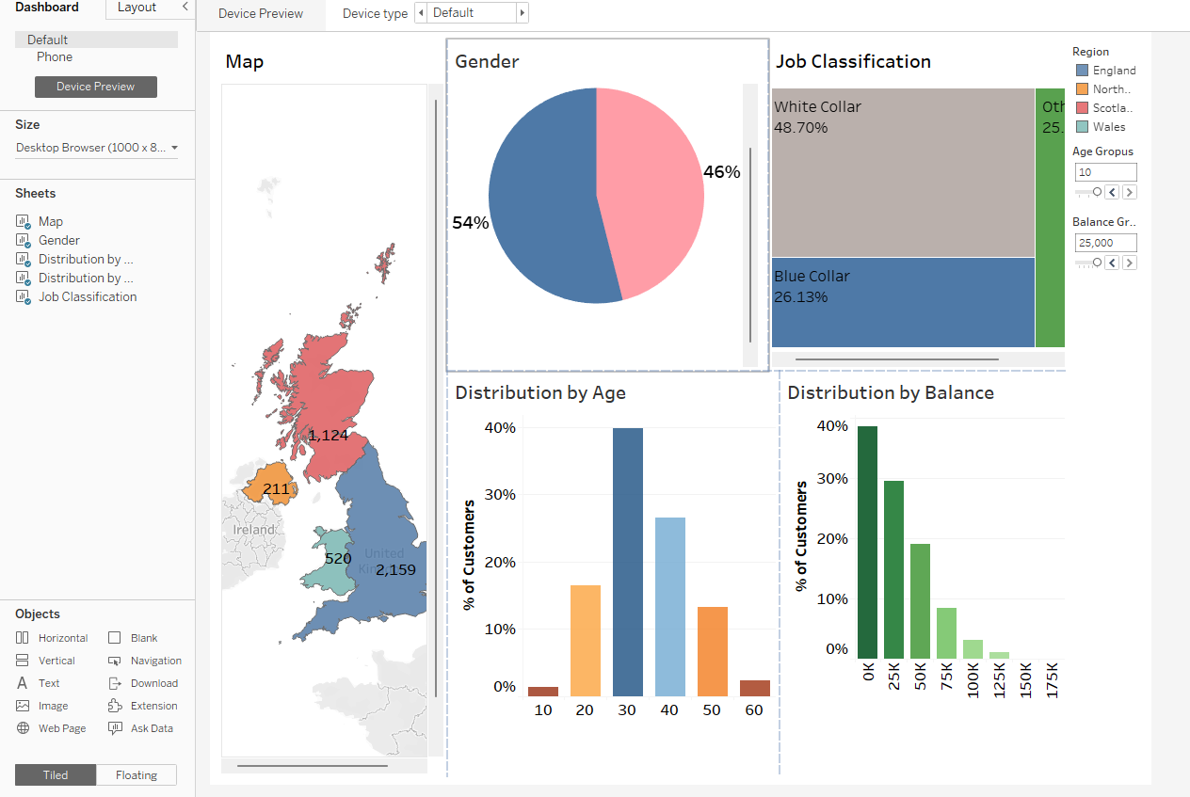
Customer Segmentation Dashboard

Slide 8
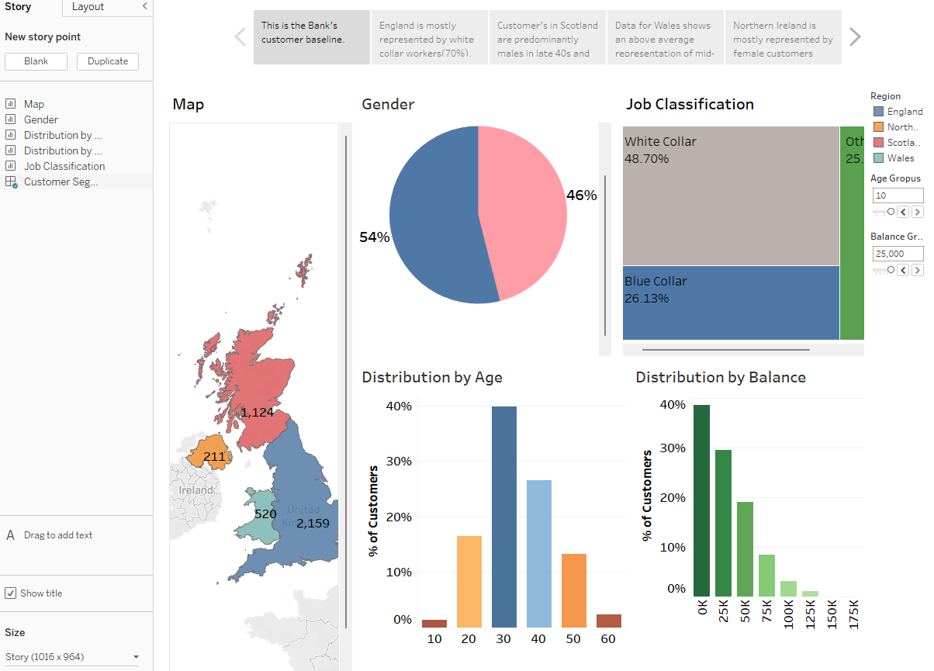
Bank Storyline

